Slide 1
Cs 470 DMV DATABASE PROJECT
tEAM MEMBERS:
Brandon Volesky
Colby Chandler
Liam Floyd
Elizabeth Koch
Mao Zheng

Slide 2
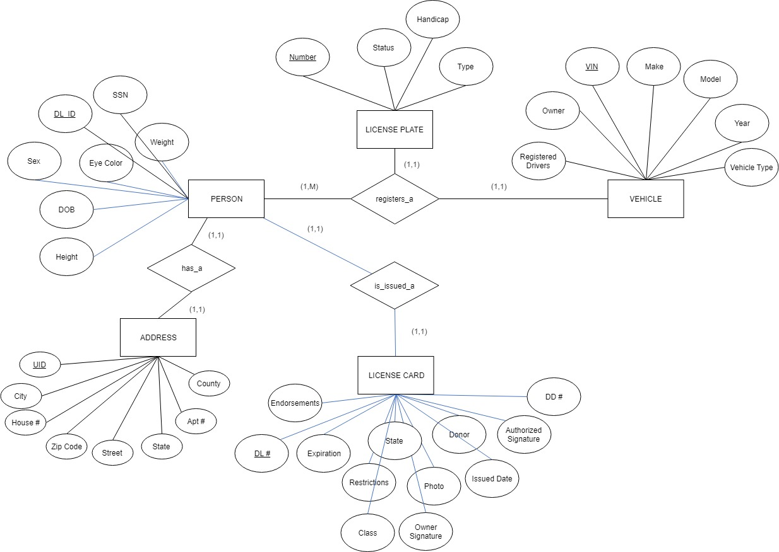
ER Diagram

Slide 3
Database architecture
This project will be utilizing the 2-tier architecture model of client-server.
The reasoning for selecting the client-server architecture was the correct fit for our query-based model. A level of simplicity was intended to be preserved by selecting this model. Because this database would only be operated by on premise employees of the DMV, our focus pivoted to internal development.

Slide 4
Database architecture
Pros:
Network peripherals are controlled centrally
Backups and network security are controlled centrally
All files are stored in a central location
Users can access shared data which is centrally controlled
Cons:
The server is expensive to purchase
Specialist staff such as a network manager is needed
If any part of the network fails a lot of disruption can occur

Slide 5
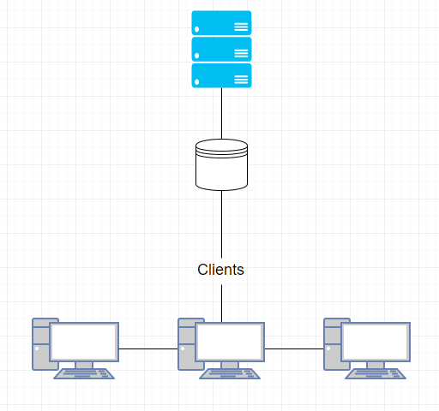
Database architecture

Slide 6
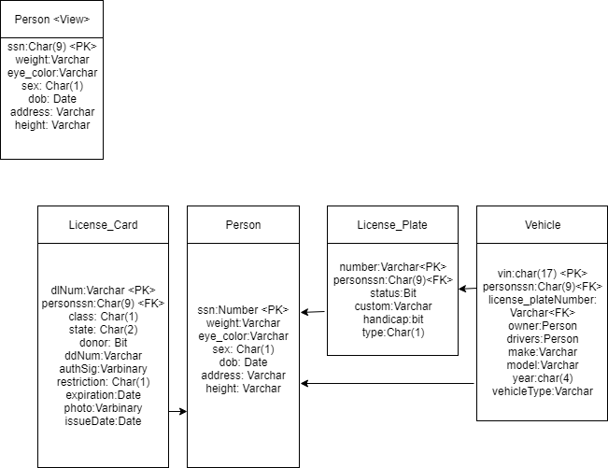
Data schema

Slide 7
Anticipated constraints and Calculated Risk
Constraints
Server must be SQL based
Project should contain multiple 1:1, 1:N and M:N relationships.
Calculated Risk
Risks | Probability | Impact | Level of Risk | Outcome
Miscommunication between team members | ●●●●○ |  |  | ●○○○○
Scheduling conflicts | ●●○○○ |  |  | ●○○○○
Burnout | ●● ○○ |  |  | ●●○○○
Developer not understanding tools | ●●●●○ |  |  | ●●●●○
◐

Slide 8
DDl
The SQL statements to create the tables are below
create table person (
dl_id varchar(10) not null,
first varchar(15) not null,
last varchar(15) not null,
ssn varchar(9) not null,
sex char not null,
eye_color varchar(3) null,
date_of_birth date not null,
height varchar(6) null,
weight varchar(3) null,
primary key(ssn)
);

Slide 9
create table license_plate (
number varchar(6) not null,
type char(1) null,
handicap bit not null,
status bit not null,
owner_dl_id varchar(10) not null,
vehicle_vin varchar(10) not null,
primary key(number)
);

Slide 10
create table license_card (
endorsements varchar(20) null,
dl_number varchar(10) not null,
expiration date not null,
restrictions char null,
state varchar(2) not null,
class char not null,
photo varbinary(50) not null,
owners_signature varchar(6) not null,
donor bit null,
issued_date date not null,
authorized_signature varbinary(50) not null,
dd_number int not null,
owner_dl_id varchar(10) not null,
primary key(dl_number)
);

Slide 11
create table vehicle (
registered_drivers varchar(6) not null,
owner_dl_id varchar(10) not null,
vin varchar(17) not null,
make varchar(20) not null,
model varchar(20) not null,
year varchar(4) not null,
vehicle_type varchar(20) not null,
license_plate varchar(6) not null,
primary key(vin)
);

Slide 12
create table address1 (
uid int not null,
owner_dl_id varchar(10) not null,
county varchar(20) not null,
house_number int not null,
apartment_number varchar(4) null,
zip_code int not null,
primary key(uid)
);

Slide 13
Create table address2 (
Zip_code int not null,
state varchar(2) not null,
street varchar(20) not null,
city varchar(30) not null,
primary key(zip_code)
);

Slide 14
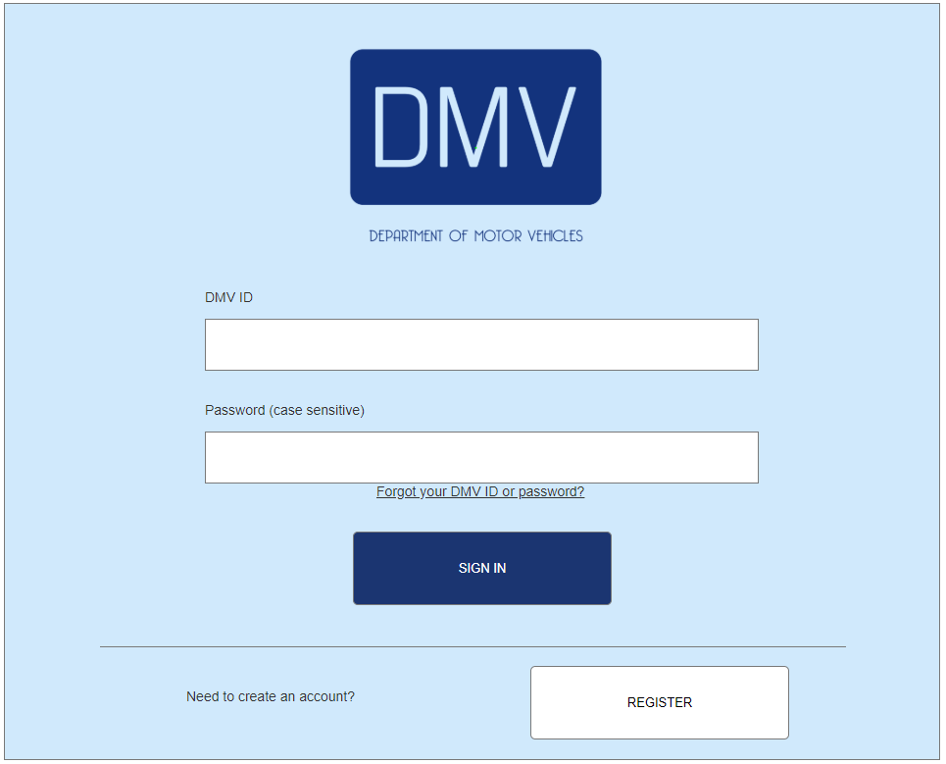
Front end design

Slide 15
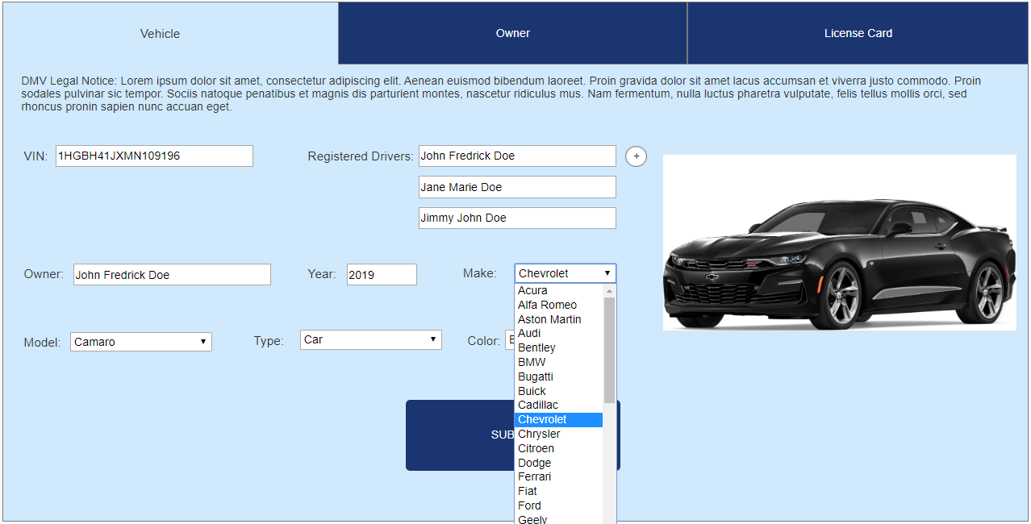
When the employee authentications into the portal, they will be greeted with three tabs along the top of the window. These tabs separate the three main functions of the employee.

Slide 16
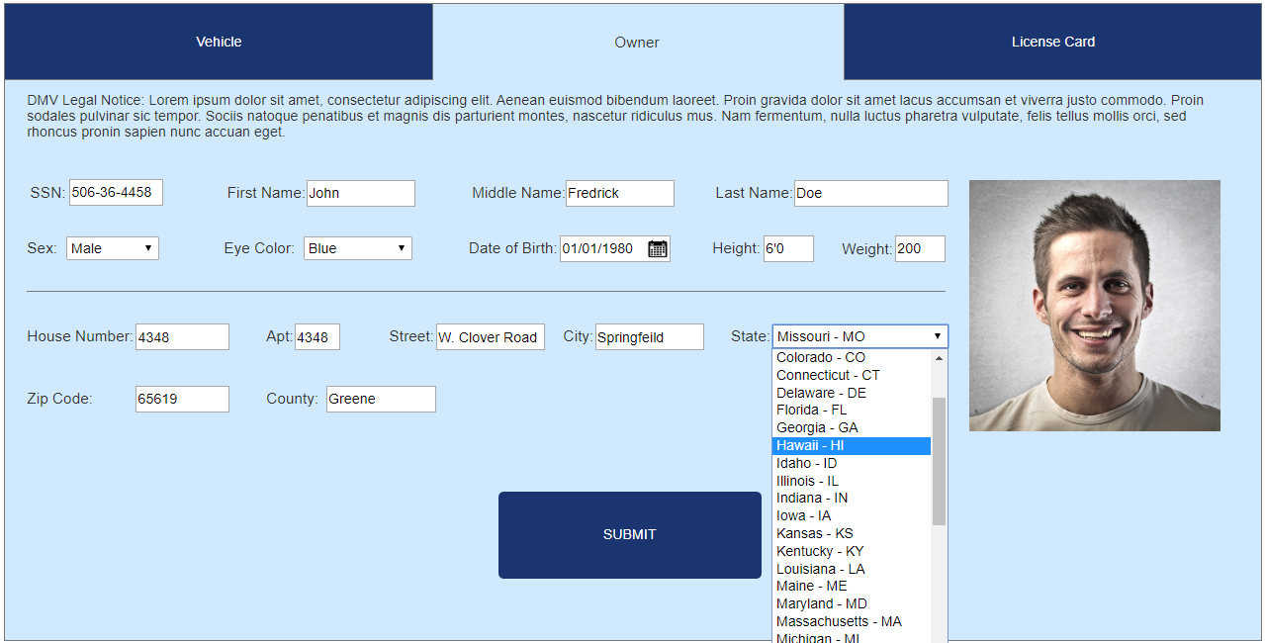
For the owner section of the UI we wanted to create a simple form that did not require scrolling. We wanted the employee’s to be able to tab through the options and be able to see all the information they have entered.

Slide 17
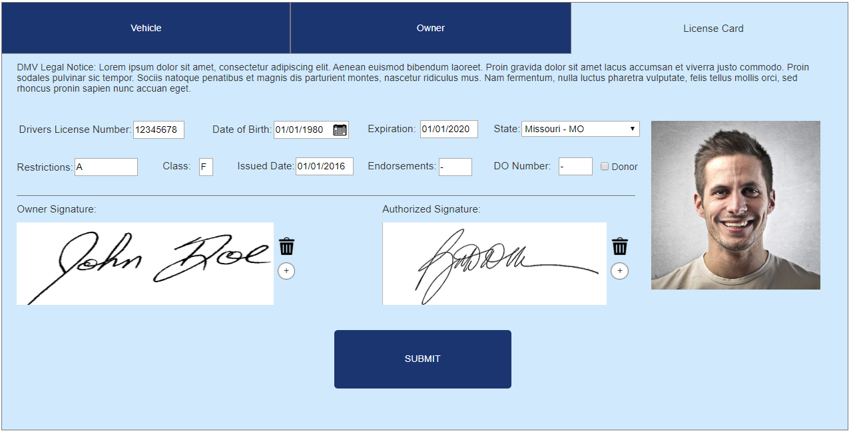
For the final tab of the interface this allows the employee to enter and review all customer data. For all these designs we followed UI gestalt rules to keep the employee from getting confused. This leads to task efficiency and subjective satisfaction.

Slide 18
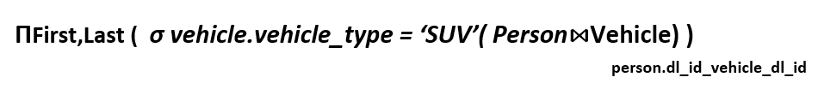

Queries and views
Query one :Get the name of all drivers who have a SUV

Slide 19

Queries and views
2. Query 2 :Find all owners who have more than 1 car

Slide 20
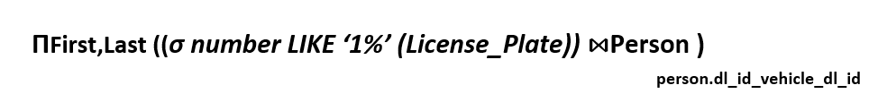

Queries and views
3. Query 3 :Find everyone who's license starts with 1

Slide 21

Queries and views
4. Query 4:Find the city of drivers of an SUV with license starting 12

Slide 22
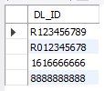
Queries and views
5. Query 5:select dl_id from Person
ΠDL_ID(Person)

Slide 23
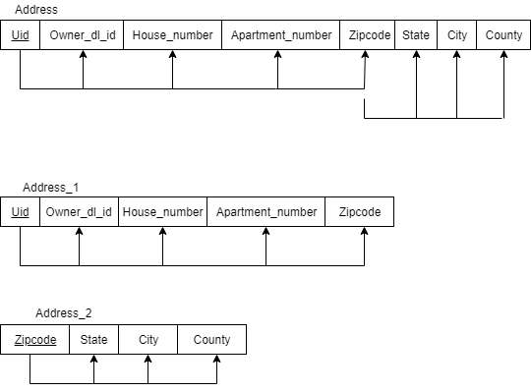
Normalization
The address was not in 3rd normal form because zip code can uniquely identify the city, state and county. The normalization resulted in the following design

Slide 24
Future Work
One thing we didn’t get about to implementing was a view for registering a new driver who just turned 16 or one who has not previously obtained a license. Currently the view requires a driver’s license number to access that driver’s data. This new view would be used by the employees to register a new user after they pass the driving test, or for those who pass the paper exam to obtain a driver’s permit at 15. Driver’s permits are not addressed at all in this database, so that is another thing that could be added. Additionally, there could be some distinction between licenses for those over and under 21, for example below 21 are vertical and above 21 are horizontal to make it easier to distinguish between the two.
Another thing that could be implemented in the future is the possibility for someone to have multiple licenses, for example if someone needs a motorcycle and a commercial driver’s license. This would change the schema quite a bit as driver’s license number is used as the foreign key throughout the database.

